Slide 1


TOWER DEFENSE GAME
Author: Le Van Quan
Instructos: Mr.Hoang, Mr.Hung
Hanoi, April 2021

Slide 2





Slide 3
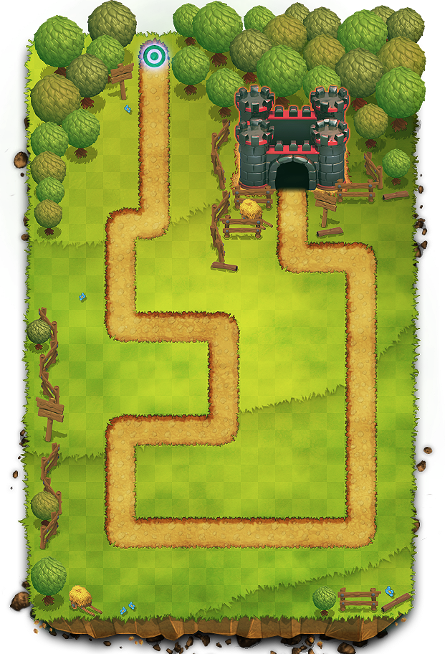









STARTING POINT
THE END

Slide 4





Slide 5
GAME CONTENT

Slide 6

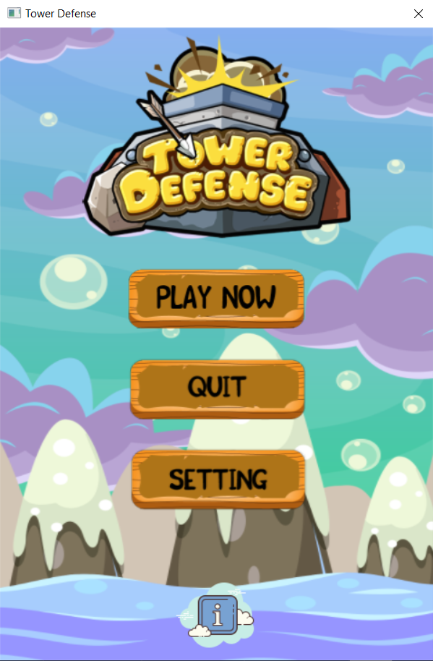
INTRO SCREEN
MENU SCREEN

Slide 7
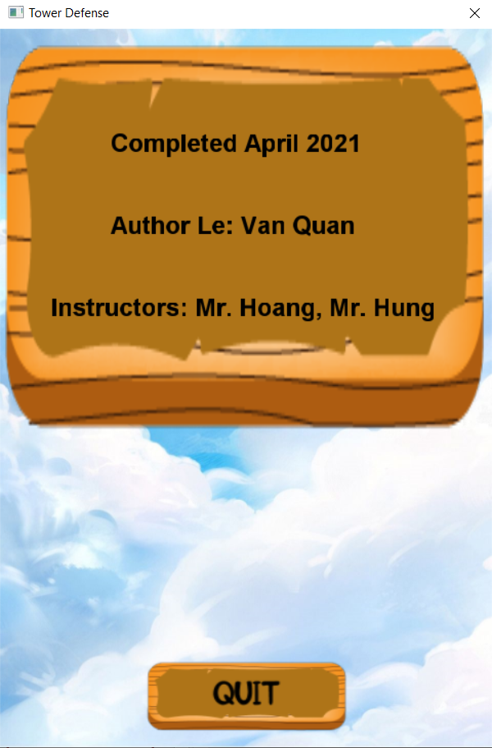
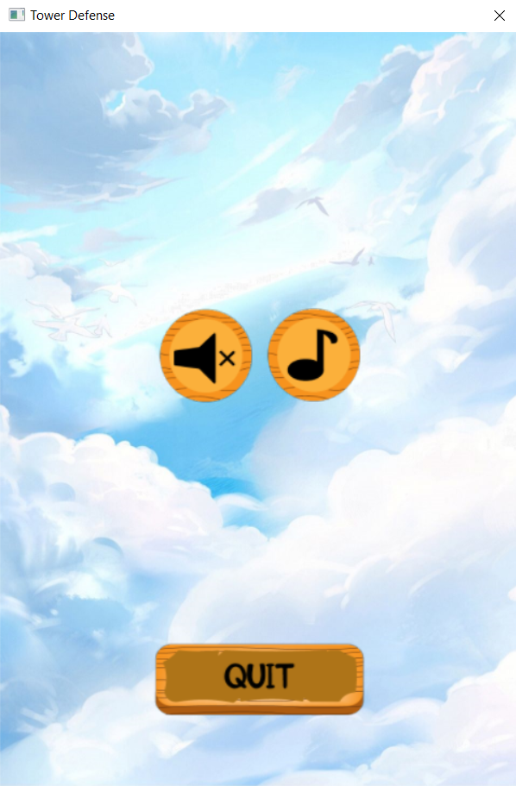
INFO SCREEN
SETTING SCREEN

Slide 8
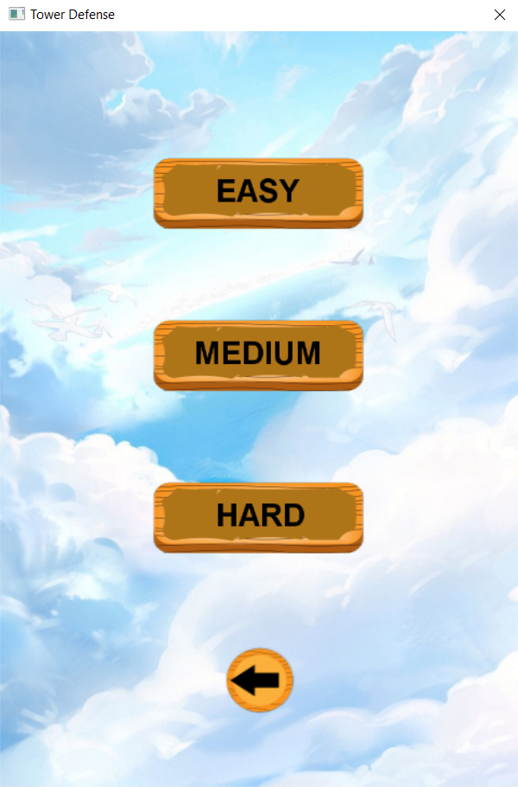
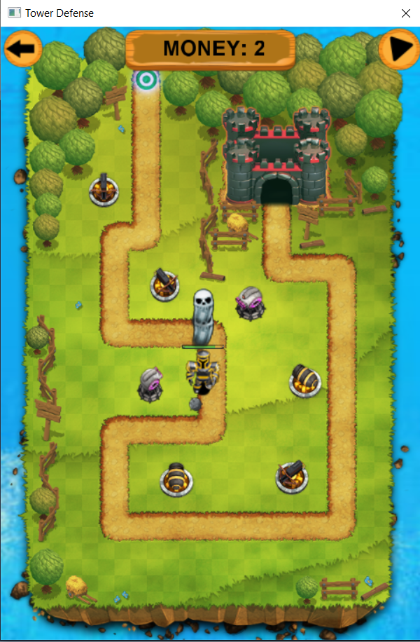
ROUND OPTION SCREEN
PLAY SCREEN

Slide 9
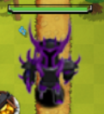

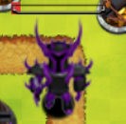
GAME PLAY

Slide 10
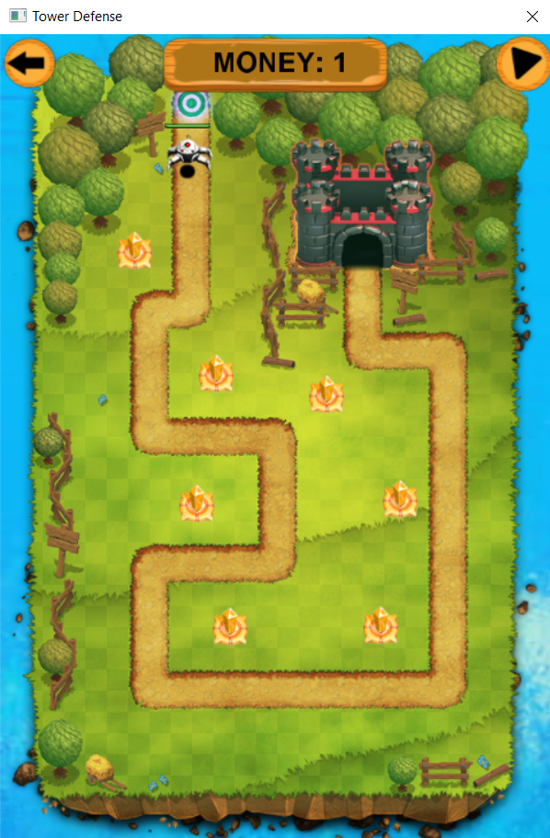




GAME PLAY
-2
-1
NOT ACTIVATED

Slide 11







Slide 12




Slide 13





Slide 14


